Slide 1
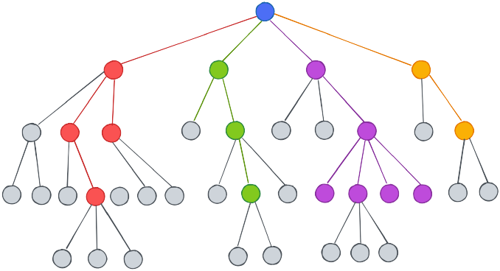
Software Project Lab-1
Topic : Classification of Data Using Decision Tree and Random Forest Based on
Three Different Criteria
Name : Pronob Karmoker
BSSE 1431
Supervisor :
Dr. Muhammad Shoyaib
Professor ,
Institute of Information and Technology,
University of Dhaka.

Slide 2
Project Outline
This project focuses on the application of advanced classification methods utilizing decision trees and random forests. The project is designed to cover the following key components:
1. Splitting Criteria:
Entropy
Gini Index
Hellinger Distance
2. Classification Metrics:
Cross Validation
Precision
Recall
Accuracy calculation & F-Score
3. Decision Tree:
- We will build three distinct decision trees, each utilizing one of the specified splitting criteria
4. Random Forest:
- The Random Forest technique will be applied, creating an ensemble of decision trees.

Slide 3
Progress till today…

Slide 4
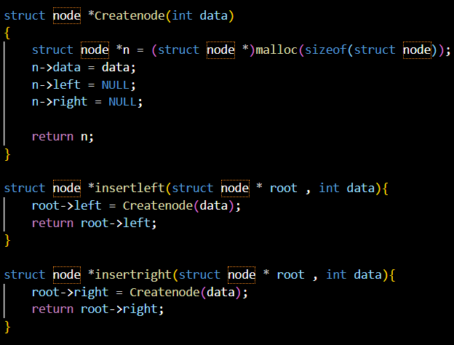
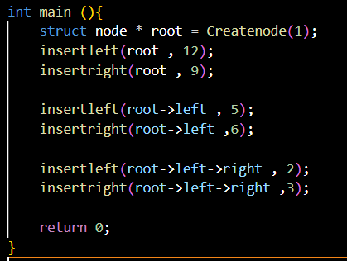
BINARY TREE
A binary tree is a hierarchical data structure composed of nodes, where each node has at most two children, which are referred to as the left child and the right child. Each node in a binary tree contains data and references to its left and right children. The topmost node in the tree, known as the root, serves as the starting point for traversal.
Note: This topic was the focus of my first assignment.

Slide 5
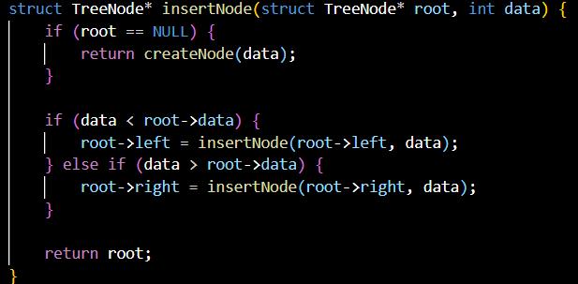
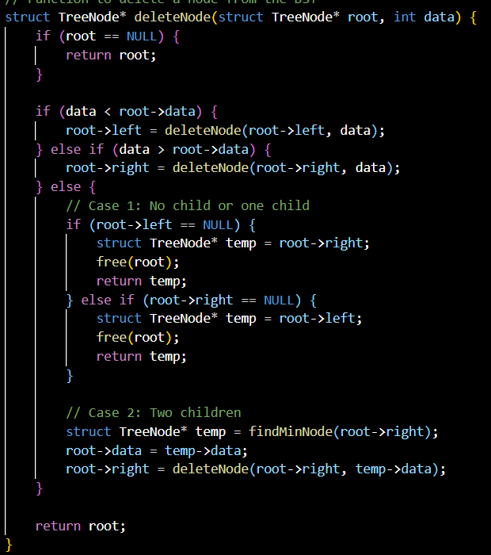
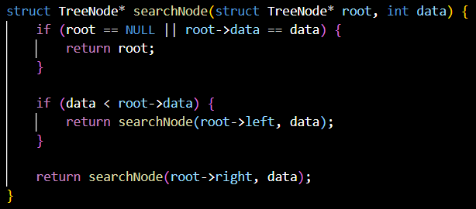
BINARY SEARCH TREE
A Binary Search Tree (BST) is a binary tree data structure in which each node has at most two children, referred to as the left child and the right child. The key property of a BST is that the values (or keys) of nodes in the left subtree are strictly less than the value of the node itself, and the values in the right subtree are strictly greater. This structural arrangement allows for efficient searching, insertion, and deletion operations.
Note: This topic was the focus of my second assignment.

Slide 6
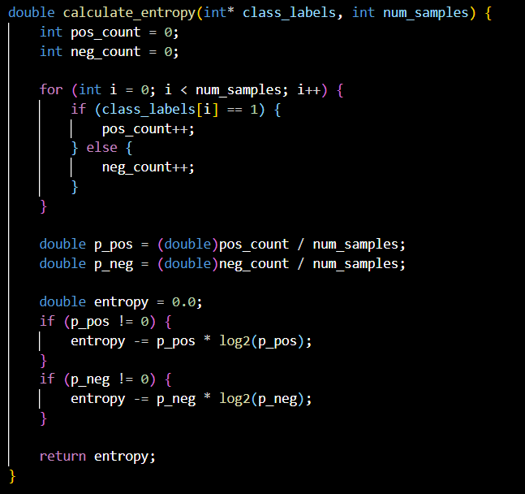
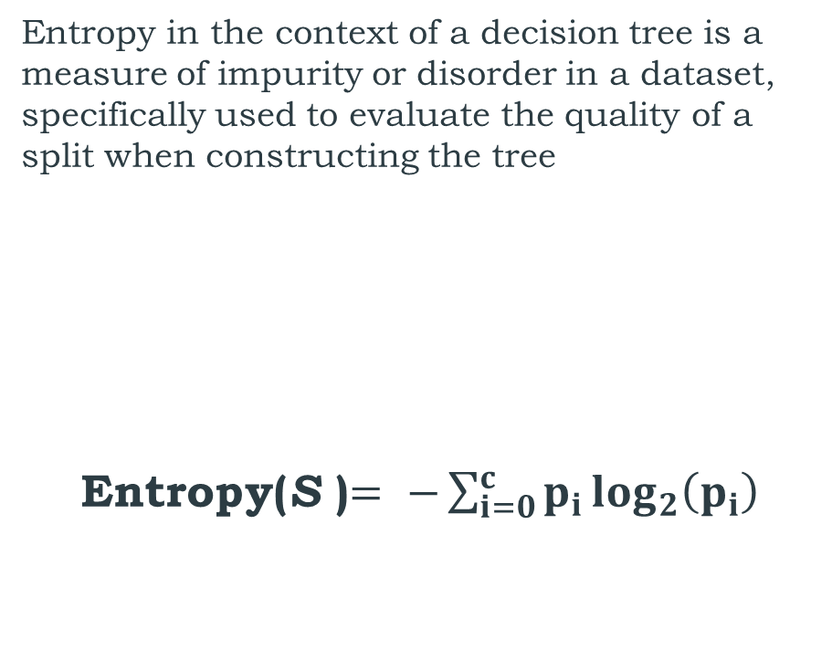
ENTROPY
Entropy in the context of a decision tree is a measure of impurity or disorder in a dataset, specifically used to evaluate the quality of a split when constructing the tree
Entropy(S )$= −\sum_{i=0}^{c}{p_{i}\log_{2}\left(p_{i}\right)}$

Slide 7
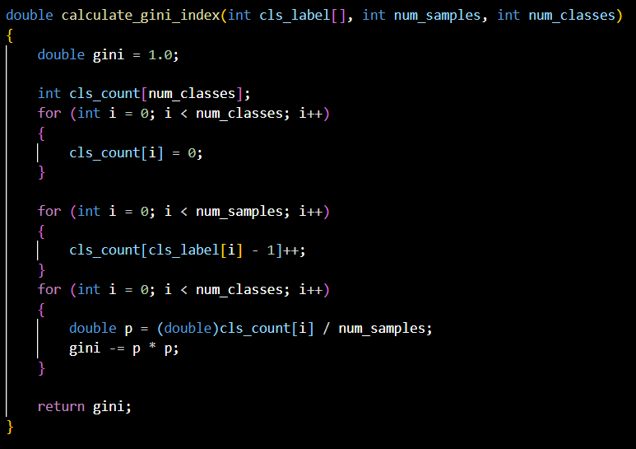
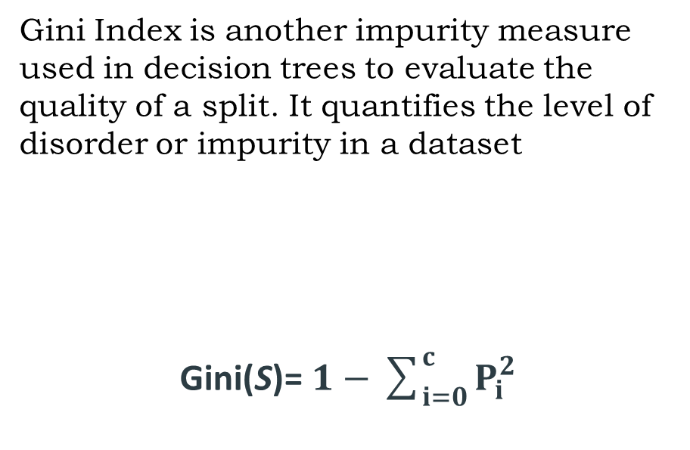
GINI INDEX
Gini Index is another impurity measure used in decision trees to evaluate the quality of a split. It quantifies the level of disorder or impurity in a dataset
Gini(S)=​ $1−\sum_{i=0}^{c}{P_{i}^{2}}$

Slide 8
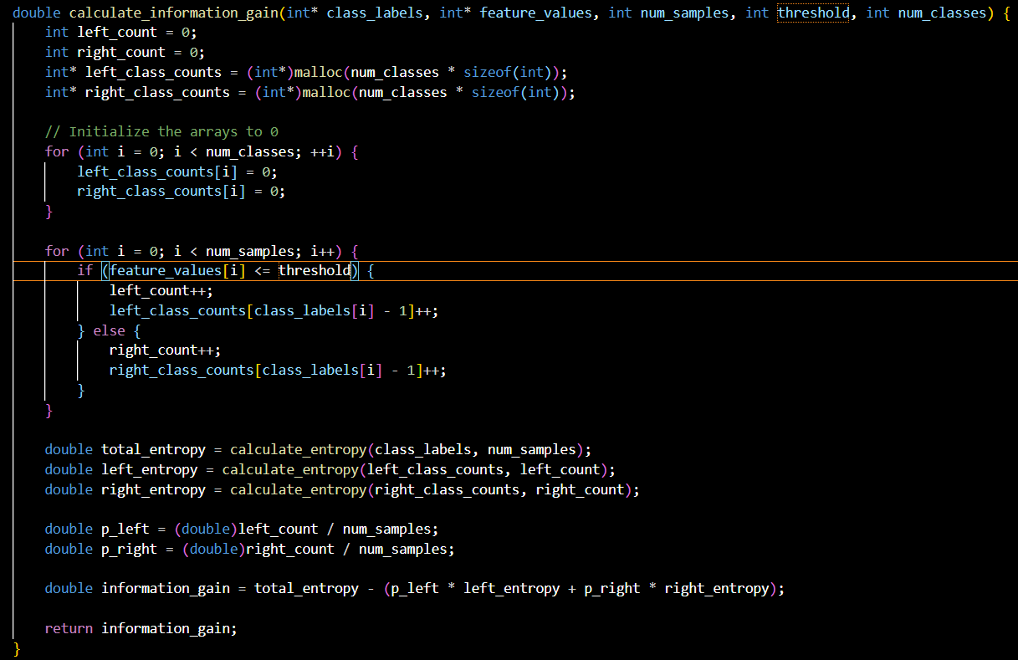
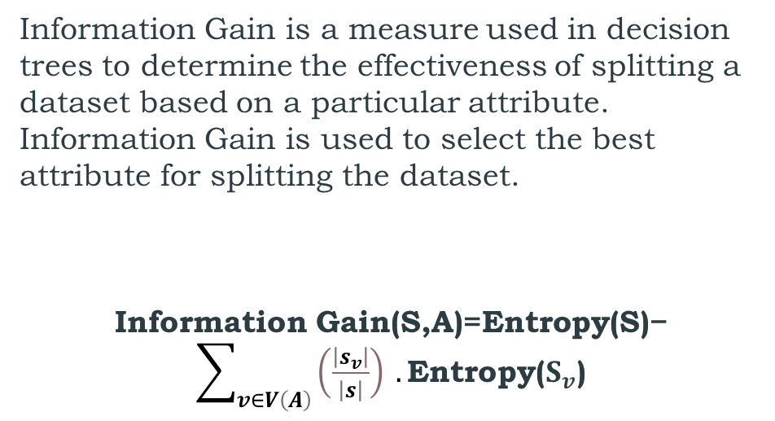
INFORMATION GAIN
Information Gain is a measure used in decision trees to determine the effectiveness of splitting a dataset based on a particular attribute. Information Gain is used to select the best attribute for splitting the dataset.
Information Gain(S,A)=Entropy(S)− $\sum_{v∈V\left(A\right)}{\left(\frac{\left|s_{v}\right|}{\left|s\right|}\right)} .\text{Entropy}\text{(}S_{v}\text{)}$
Information Gain = Total Entropy - (Weighted Average of Left Entropy + Weighted Average of Right Entropy)
NOTE: We can utilize this formula in place of the entropy formula when calculating the Gini Index.

Slide 9
Decision Tree
A decision tree is a hierarchical, non-parametric supervised learning algorithm used for classification tasks. It comprises a tree-like structure with a root node, branches, internal nodes, and leaf nodes. Each internal node represents a decision based on a feature, leading to one of its child nodes, while each leaf node represents a class label or a regression value. Decision trees are constructed to optimize decision-making by partitioning the data based on specific criteria, typically to maximize information gain or minimize impurity measures such as Gini Index or Entropy

Slide 10
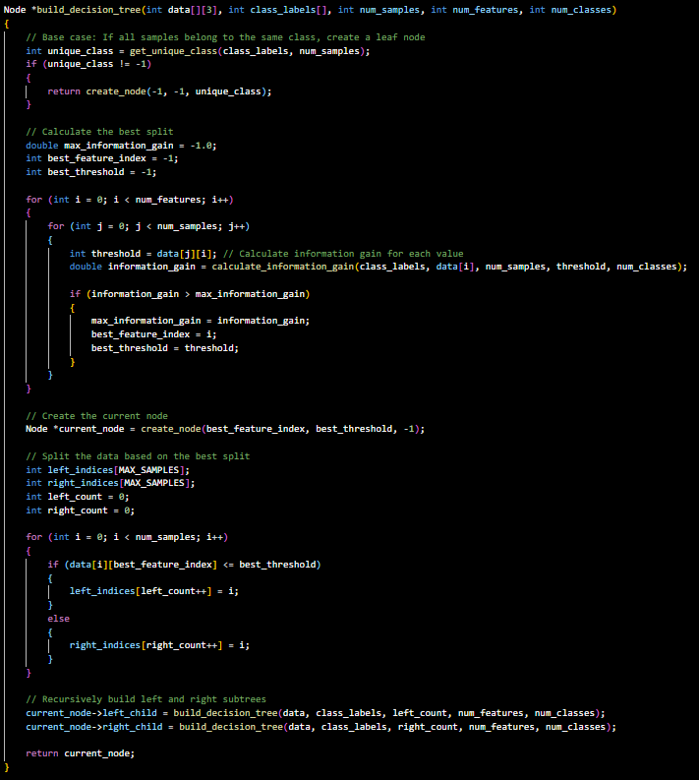
BUILD DECISION TREE
Procedure: Building a Decision tree
Base Case Check
Finding the Best Split
Creating the Current Node
Splitting the Data
Recursion.
Building the Decision Tree

Slide 11
To be continued…
My future goals regarding this project include implementing…
Hellinger Distance
Classification metrics :
Cross Validation
Precision
Recall
Calculating Accuracy and F-Score
Random Forest
Here is my Repository link for spl-1: https://github.com/pronobkarmoker/SPL-1

Slide 12
THANK YOU!!!

